Slide 1
CMSC201
Computer Science I for Majors
Lecture 03 - Variables

Slide 2
Last Class We Covered
Algorithms
Program Development
Control Structures
  Sequential
  Decision Making
  Loops
Types of Errors
  Syntax
  Logic

Slide 3
Any Questions from Last Time?

Slide 4
Exercise
What will each of the following do?
print("Hello')
  Error – Need to have matching ' and "
Print('Hello')
  Error – Need to have lowercase print
print('Hello World')
  Hello World

Slide 5
Today’s Objectives
To start learning Python
To learn more about variables
  How to use them
  Different types
To learn how to use input and output
  To do interesting things with our program
To play a party game

Slide 6
Software Development Process
A quick reminder about the process we follow
Analyze the problem
  Determine specifications (requirements)
Create a design
Implement the design
Test and debug the program
Maintain the program

Slide 7
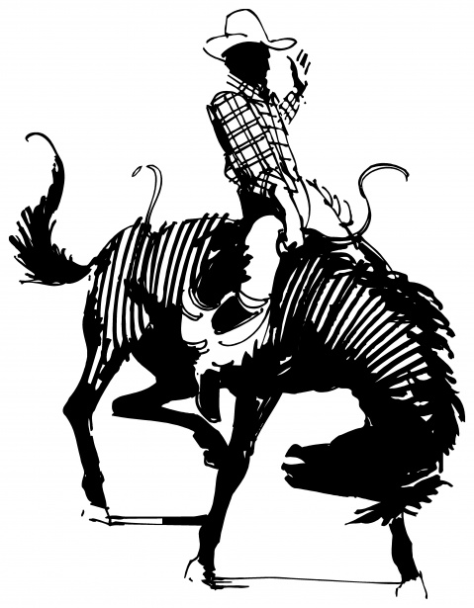
Don’t “Cowboy Code”
“Cowboy coding” is when you jump right in to writing code without planning beforehand
  No formal management of project
  No standard way of coding
  Not planning things out
    Forgetting to include important things
    Having to make big changes later
Image from www.publicdomainpictures.net
Notes:
www.publicdomainpictures.net/view-image.php?image=154191

Slide 8
Example: Temperature Converter
You have been invited to live in Europe during a semester abroad. You aren’t sure how to dress because the temperature is given in Celsius.
Problem:
  Temperature is given in Celsius
Solution:
  Write a program to convert Celsius to Fahrenheit

Slide 9
Input/Process/Output
Input
  What information do you need for your converter?
Process
  What formulas do you need for your converter?
Output
  What is the output from your converter?

Slide 10
Introduction to Python
(Variables)

Slide 11
Python
Python is a widely used language
  General purpose
  High-level language
Emphasizes code readability
  More streamlined than some other languages

Slide 12
“Hello World!”
In Python:
  print("Hello World!")
In the C++ programming language:
  #include <iostream>
  int main() {
  std::cout << "Hello World!\n";
  }

Slide 13
Elements of a Program
Identifiers
  Variables
  Modules (later in the semester)
  Functions (later in the semester)
Expressions
  Code that manipulates or evaluates identifiers

Slide 14
We Start Python Today!
Two ways to use Python
  You can write a program as a series of instructions in a file and then execute it
  You can also test simple Python commands in the Python interpreter
We will write programs for assignments
Use the interpreter to help you test things

Slide 15
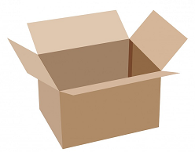
What Is a Variable?
Something that holds a value
  Can change (unlimited number of times)
Similar to variables in math
In simple terms, a variable is a
“box” that you can put stuff in
Image from pixabay.com
Notes:
https://pixabay.com/p-220256/

Slide 16
Rules for Naming Variables
Variables can contain:
  Uppercase letters (A-Z)
  Lowercase letters (a-z)
  Numbers (0-9)
  Underscores (_)
Variables can’t contain:
  Special characters like $, #, &, ^, ), (, @
Image from https://www.flickr.com/photos/rtgregory
Notes:
https://www.flickr.com/photos/rtgregory/1332596877

Slide 17
More Rules for Naming Variables
Variables can be any length
  x
  IsKanyeRunningForPresidentIn2020
  myName
Variables cannot start with a digit
  2cool4school is not a valid variable
  cool4school is a valid variable

Slide 18
Variables and Keywords
Keywords are the reserved words in Python
Variables cannot be keywords
  or is not a valid variable name
  orange is an acceptable variable name
False | class | finally | is | return
None | continue | for | lambda | try
True | def | from | nonlocal | while
and | del | global | not | with
as | elif | if | or | yield
assert | else | import | pass
break | except | in | raise

Slide 19
Exercise: Variables
Are the following legal or illegal in Python?
1spam
No – Illegal!
raise1
Yes – legal!
Spam_And_Eggs
Yes – legal!
But it doesn’t follow
our coding standards!
spamAndEggs or
spam_and_eggs

Slide 20
Using Variables in Python
You create a variable when you declare it
You also need to initialize it before using
  Use the assignment operator (equal sign)
richFiddy = 50000000
poorFiddy = 0.50
brokeFiddy = 0
assignment operator

Slide 21
Introduction to Python
(Expressions)

Slide 22
Expressions
Programs manipulate data
  Allows us to do interesting things
Expressions calculate new data values
Use assignment operator to set new value

Slide 23
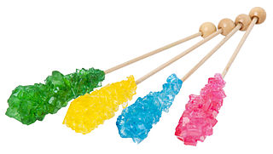
Expressions Example
  numCandy = 4
  priceCandy = 0.58
  totalCost = numCandy * priceCandy
variable being set
assignment operator
value (a “literal”)
expression
Image from wikimedia.org
Notes:
https://commons.wikimedia.org/wiki/File:Rock-Candy-Sticks.jpg

Slide 24
Common Mistake
Many new programmers mix up the left and right hand sides of the assignment operator
  Variable being set is on the left
  Expression is on the right
  Evaluate the expression first, then assign the value
✓
numCandy = 4 + 1
✗
4 + 1 = numCandy

Slide 25
Variable Types
There are many different kinds of variables!
  Numbers
    Integers
    Floats (decimals)
  Booleans (True and False)
  Strings (collections of characters)

Slide 26
Variables Types: Examples
  aString = "Hello class"
  float_1 = 1.12
  myBool = True
  anInteger = 7
  dogName = "Ms. Wuffington"
  classCode = 201

Slide 27
Variable Usage
Variables are designed for storing information
Any piece of information your program uses
or records must be stored in a variable
  Python doesn’t have a “short term memory,” so everything needs to be written down for it

Slide 28
Introduction to Python
(Input and Output)

Slide 29
Output
Output is text that is printed to the screen
  So the user can see it (and respond)
The command for this is print
  Use the keyword “print” and put what you
  want to be displayed in parentheses after it

Slide 30
Output Example
print (3 + 4)
print (3, 4, 3 + 4)
print()
print("The answer is", 3 + 4)
7
3 4 7
The answer is 7
What does this output to the screen?

Slide 31
Output Exercise 1
What will the following code snippet print?
a = 10
b = a * 5
c = "Your result is:"
print(c, b)
Your result is: 50

Slide 32
Output Exercise 2
What will the following code snippet print?
a = 10
b = a
a = 3
print(b)
10
There are two possible options for what this could do! Any guesses?

Slide 33
Output Exercise 2 Explanation
Why does it print out 10?
When you set one variable equal to another, they don’t become linked!
  They are separate copies of a value
After b is set to 10, it no longer has
anything else to do with a

Slide 34

Output Exercise 2 Explanation
a = 10
b = a
a = 3
print(b)
10
a
Image from pixabay.com
Notes:
https://pixabay.com/p-220256/

Slide 35
Output Exercise 2 Explanation
a = 10
b = a
a = 3
print(b)
10
10
a
b
Image from pixabay.com
Notes:
https://pixabay.com/p-220256/

Slide 36
Output Exercise 2 Explanation
a = 10
b = a
a = 3
print(b)
10
10
3
a
b
Image from pixabay.com
Notes:
https://pixabay.com/p-220256/

Slide 37
Output Exercise 2 Explanation
a = 10
b = a
a = 3
print(b)
output:
10
3
10
a
b
Image from pixabay.com
Notes:
https://pixabay.com/p-220256/

Slide 38
Input
Input is text we get from the user
  We must tell them what we want first
  userNum = input("Please enter a number: ")
  print(userNum)
The output and input will look like this:
  Please enter a number:
  22
22

Slide 39
How Input Works
  userNum = input("Please enter a number: ")
Takes the text the user entered and stores it
  In the variable named userNum
You can do this as many times as you like!
  userNum = input("Enter another number: ")
  userNum2 = input("Enter a new number: ")
  userAge = input("Please enter your age: ")

Slide 40
Input as a String
Everything that comes through input()
will come in the form of a string
There is a difference between "10" and 10
  "10" is a string containing two characters
  10 is understood by Python as a number

Slide 41
Converting from String
To turn an input string into a number,
you can do the following:
  aNum = input("Enter a number: ")
  aNum = int(aNum)
int stands for “integer” (a whole number)
You can also do it in one line:
  aNum = int(input("Enter a number: "))

Slide 42
Converting from String
Do you think the string "1,024" will work
if we try to cast it as an integer? Why?
It won’t work, because comma isn’t a number
We can cast to other data types as well
  flt = float(input("Enter float: "))

Slide 43
Exercises

Slide 44
Exercise: Calculating Averages
Write, on paper or on your computer, a program that asks the user for two numbers and prints out the average.
Make sure to use variables, and to get the input from the user!
Does the order of operations come into play for this exercise?

Slide 45
Exercise: Assignment Weighting
Pretend you’re writing a program to compute someone’s weight grade. You have so far:
  hwWeight = 0.4
  examWeight = 0.5
  discussionWeight = 0.1
Write a program that then asks the user for their homework grade, exam grade, and discussion grade and prints out their total grade in the class.

Slide 46
Class Exercise: Mad Libs
Mad Libs is a word game where one player prompts the others for different types of words, using them to fill the blank in a story.
The result is often hilarious, and almost always nonsensical.

Slide 47
Announcements
Your discussions (Labs) start in person this week!
  Go to your scheduled location and time
Homework 1 is out (on Blackboard)
  Due by this Wednesday (Sep 14) at 8:59:59 PM
  Complete the Syllabus/Course Website Quiz to see it
Academic Integrity Quiz on Blackboard soon
  Must complete to see Homework 2

